Slide 1
Troop 497 2024 Car Wash
General Information
Car Wash Audio
Rose Royce - Car Wash [LYRICS] - YouTube

Slide 2
Troop 497 Car Wash – Expected Participation
Seek & collect pledges from friends and neighbors as well as corporate sponsors totaling at least $200.
Ask your parents, neighbors, friends and relatives to bring their cars to the free car wash.
Show up on the day of the car wash June 1st and help wash cars, get wet and have fun!

Slide 3
Troop 497 Car Wash – Pledge Sponsors
Get pledges from friends and neighbors on a flat pledge or on a per car basis. Note we usually wash about 500 cars.
Flat Pledge Example: Flat $50 donation pledge can be collected and turned in before or after the car wash event.
Per Car Example: A Dime per car ($0.10) would be $50 if we wash 500 cars. Funds must be collected and returned in after the car wash once we know the number of cars washed.

Slide 4
Troop 497 Car Wash – Corporate Sponsors
Get corporate sponsors from local businesses that donate a flat pledge in return for the troop passing out their advertising materials (business cards, fliers, samples, coupons, etc.) in our sponsor bags at the start of the car wash.
Corporate Sponsor Levels
1st Class - $50
Star - $100
Life - $150
Eagle - $200
Corporate sponsor pledges and materials should be collected and turned in at least 2 weeks prior to the car wash to ensure that they get added to the sponsor banner and added to the sponsor bags.

Slide 5
Troop 497 Car Wash – Funds Distribution
First $200 is split 50/50 between the Troop and the Scouts account that can be used for any scout related activity or equipment.
Any funds in excess of $200 will be 100% deposited in the Scout’s account.
You can easily pay for Summer and High Adventure camps if you get several corporate sponsors!
Note: Scout accounts are by scout, not family, so each scout is expected to get at least $200 in pledges.

Slide 6
Troop 497 Car Wash – Advertise the Car Wash
Ask your parents, neighbors, friends and relatives to bring their cars to the free car wash.
Print out and provide fliers for corporate sponsors to give to their customers.
Give Car Wash reminder cards to all your friends and family, even if they don’t provide a pledge donation.
Remind your sponsors the week before the car wash date!

Slide 7
Troop 497 Car Wash – Car Wash Day
Show up on the day of the car wash and help wash cars, get wet and have fun! - June 1st (Rain Date is June 8th)
You will get soaking wet; wear appropriate clothes (bathing suit) and water shoes.
Bring a hat, sun glasses, water bottle and special sunscreen if needed.
Troop will provide event T-Shirt, sunscreen, breakfast, lunch, and water/sodas.

Slide 8
Troop 497 Car Wash – Car Wash Jobs
Scouts:
Seniors will lead teams that wash all cars and act as mop men to bring cars into the car wash from York Road.
Scouts will wash cars using hand cloths, pole brushes, and wheel brushes. No Scouts will use hoses!
Adults:
Many adults are needed for all the other car wash activities like:
Car Greeters - hand out sponsor bags
Prewash Pressure Washer / Lane Director
Prewash Rinse Hose Sprayer
Adult Wash Quality Inspector
Final Rinse Hose Sprayer – Here is your chance live your childhood fireman dreams!
Donation Bucket & Car Tag Recorder

Slide 9
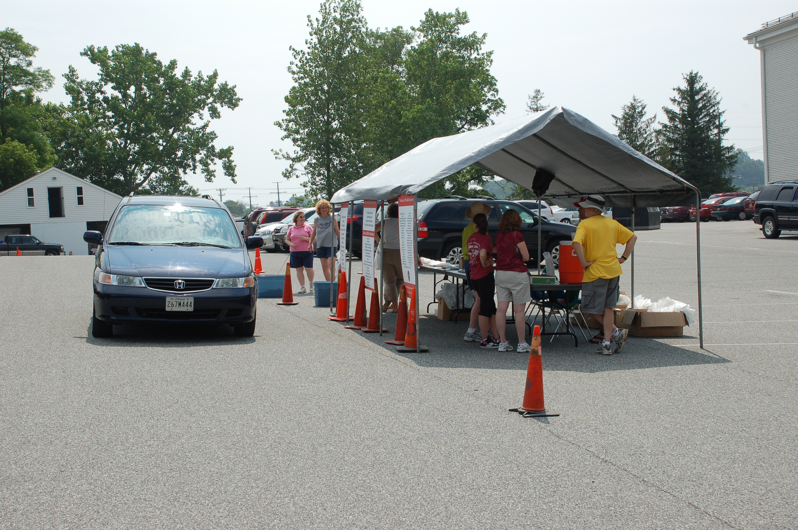
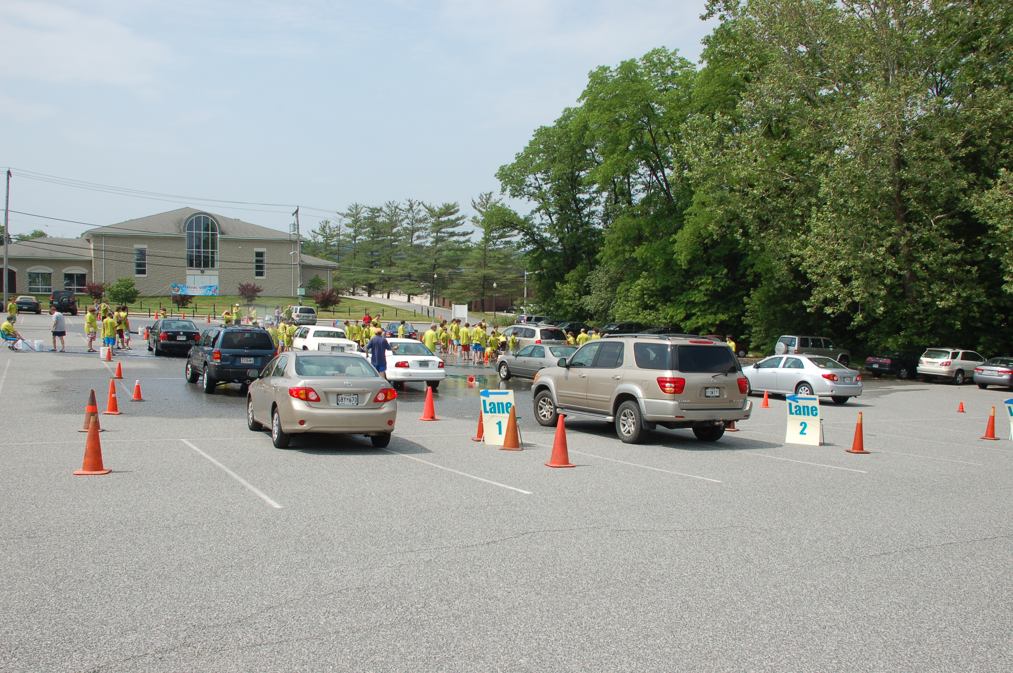
Troop 497 Car Wash – Past Photos

Slide 10
Troop 497 Car Wash – T-Shirt Design Contest
All Scouts are welcome to submit a design for the Car Wash T-Shirt.
Must be letter paper size, i.e. 8.5x11.
One color for image and text (usually white or black).
Must be in electronic format, JPG is best.
Must be submitted to Mr. Mann by May 2nd
Must not contain any offensive messages, signs, or trademarked images.
We will vote on winning design at the May 9th Troop meeting.
Please see Mr. Mann for more information!
Jeff@Mann-Home.com
443-377-6699

Slide 11
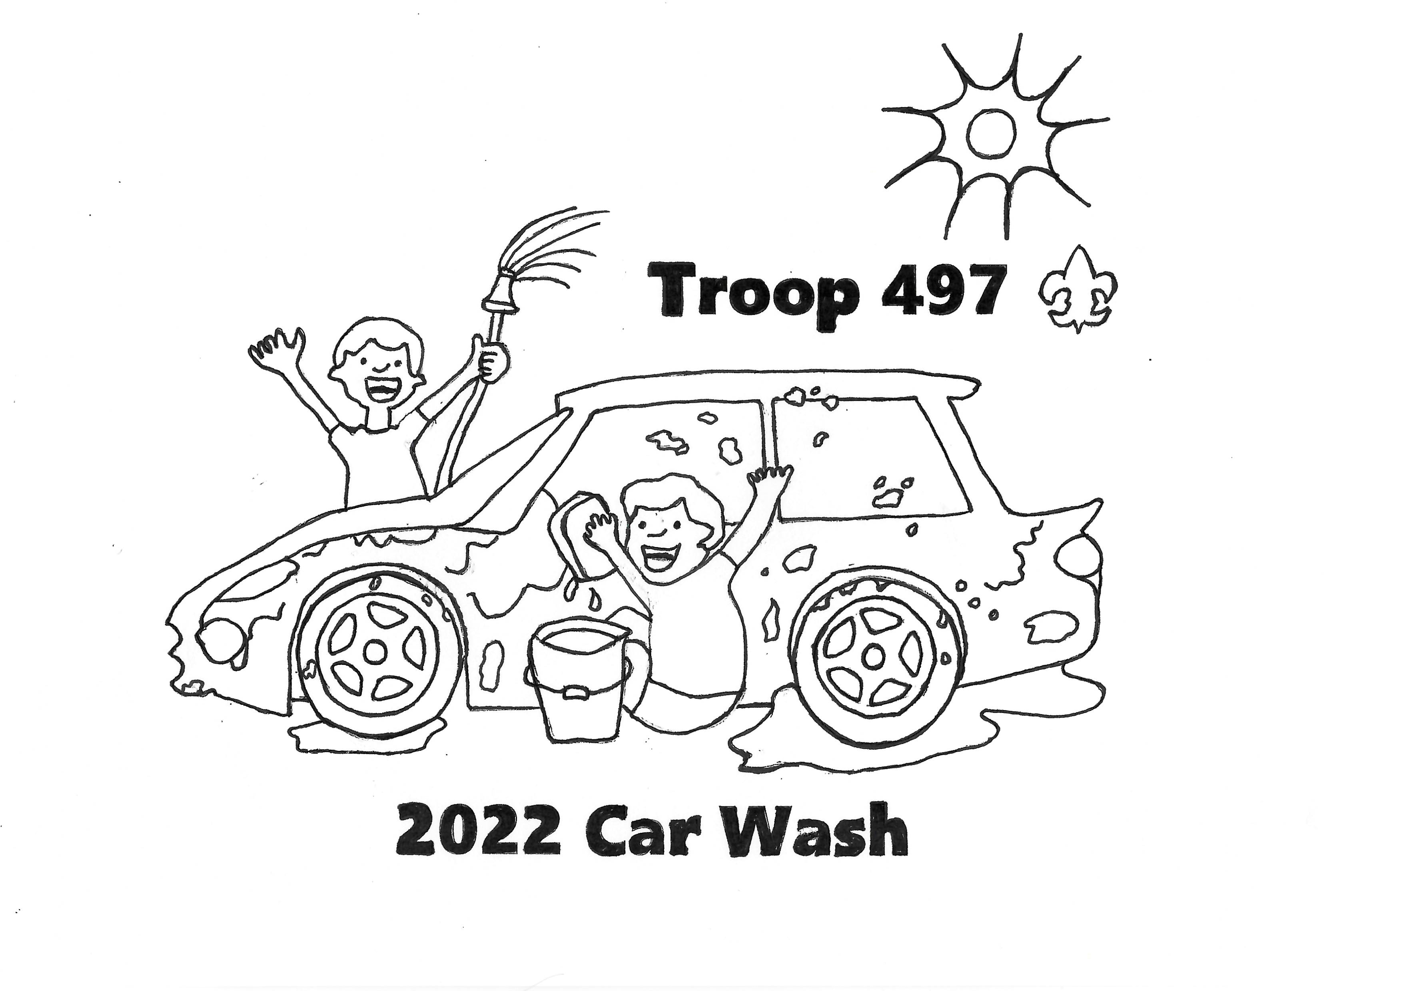
Troop 497 Car Wash – T-Shirt examples

Slide 12
Troop 497 Car Wash – Questions?

